Slide 1
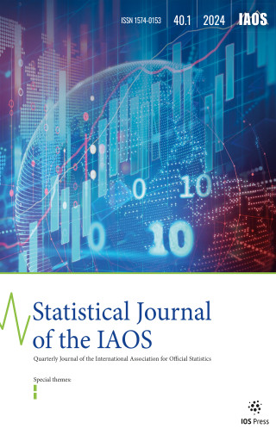

Slide 2
The Statistical Journal of the IAOS
The Statistical Journal of the IAOS (SJIAOS) is the flagship journal of the International Association for Official Statistics.
Its main aim is to support the IAOS mission by publishing articles that promote the understanding and advancement of official statistics and that foster the development of effective and efficient official statistical services on a global basis.
Additional objectives:
Promoting the debate on emerging strategic topics in official statistics
Promoting methodological advancements in official statistics
Promoting the use of the Journal as reference for official statisticians around the world & for non-experts (statistical literacy)
SJIAOS website: officialstatistics.com

Slide 3
The Statistical Journal of the IAOS
In 2023:
4 regular issues published (Volume 39)
1016 pages of content
78 articles (excluding editorials and discussion platform)
38 Free/Open Access (49%)
225 Authors involved
Out of 127 articles submitted, 35 were rejected (28%)
SJIAOS website: officialstatistics.com

Slide 4
Content: Editorials
Year | Issue | Topic
2024 | June | The 55th session of the UN Statistical Commission: promoting inclusivity and protecting statistical systems from political interference (upcoming)
2024 | March | Embracing Open Access and FAIR Publishing Principles
2023 | Dec. | Present and future of the European Master in Official Statistics
2023 | Sept. | Charting the Course for the Next Biennium
2023 | June | The times they are a-changing
2023 | March | Success, failures, challenges, and opportunities for official statistics in the development and implementation of the SDG Indicator framework

Slide 5
Content: discussion platform
Year | Nr | Topic
2024 | 20 | Good data are useful data (upcoming)
2024 | 19 | What qualities are needed by statisticians to achieve top leadership positions?
2023 | 18 | Are Data Scientists Going to Replace Statisticians?
2023 | 16 -17 | The impact of AI and the availability of data in the so-called Data ecosystem on the development of official statistics.
2023 | 15 | Success, failures, challenges and opportunities for official statistics in the development and implementation of the global SDG indicator framework
2023 | 14 | How can Official Statistics find a way out of the fog?

Slide 6
Article Views
Year | 2020 | 2021 | 2022 | 2023
Views | 33,317 | 51,672 | 90,589 | 70,347
Total Papers | 158 | 145 | 154 | 103
% OA Papers | 89% | 63% | 80% | 59%
Analysis
After a steep increase in the number of article views up to 2022 (almost tripled from 2020 to 2022) there has been a decrease in 2023. The main reasons are:
Transition period due to the handover of the Editor in Chief role
No Special Issue (funded by International Organizations) published
Significant reduction in the number of articles published (mainly those voluntarily submitted)
Significant reduction in the proportion of Open Access articles

Slide 7
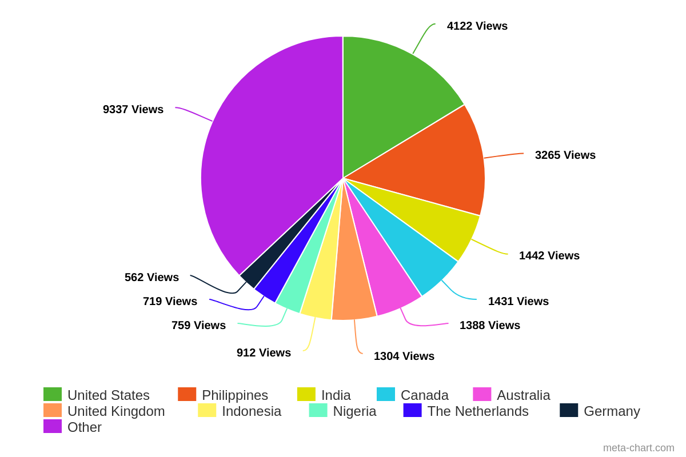
Breakdown of visitors to the content library per country in 2023
officialstatistics.com

Slide 8
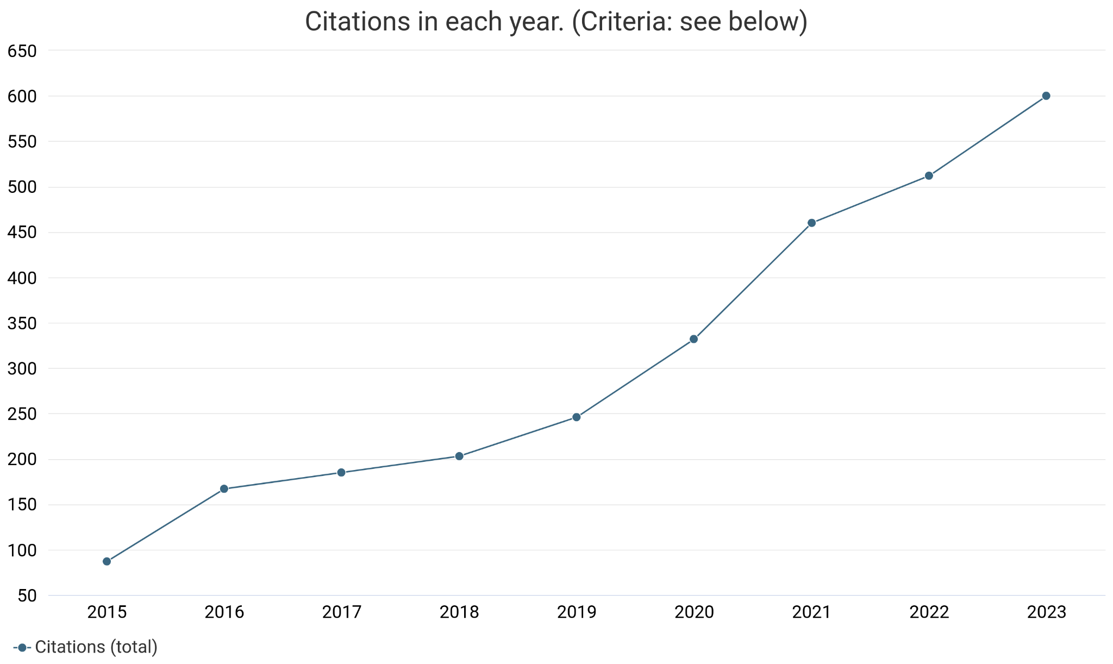
Journal Altmetrics
Publication citations: number of times that publications have been cited by other publications in the database.
The chart shows the number of citations received in each year.
On this basis the SJIAOS will be submitted for evaluation to Clarivate for ranking in the Web of Science and ESCI this year.
Based on data from Dimensions

Slide 9
Main Initiatives in the last 9 months
New Cover of the Journal
Injection of new blood in the Editorial Board (18 new Editors)
Organization of regular meetings with the Emphasis Editors
Changes to the manuscripts’ review process: new letters’ templates and deadlines for Emphasis Editors and Reviewers
Adoption of the International Classification of Statistical Activities to classify articles and Reviewers
Strengthened communication (social media, newsletters) and outreach
Newsletter dispatched to all Heads of NSOs and of International Organizations
Active scouting for Special Issue and for funding of Open Access articles
Proposal for a new business model of the Journal: Open access for users; Costs covered by Institutional membership fees

Slide 10
Upcoming Issues

Slide 11
Volume 40, Issue 2
Expected publication date: June 15 - 2024
Themes:
Special Issue: The Future of Agricultural Statistics
This section of the Journal, comprises 12 papers selected from those presented at the ninth International Conference on Agricultural Statistics (ICAS IX), which was held at the World Bank headquarters in Washington, DC, on May 17–19, 2023.
Surveys in Times of COVID-19 and in Difficult Settings
Statistics Netherlands' adaptation to mixed-mode surveys amidst the pandemic and a simulation study evaluating sampling methods in challenging contexts.
Time Series Analysis
This section comprises five papers that delve into various aspects of time series analysis and its applications in economic research and forecasting.

Slide 12
Volume 40, Issue 3
Expected publication date: September 15 - 2024
Themes:
Special issue: “Understanding the informal economy and informal employment – the statistical challenge”
12 papers planned
Special topic: “Understanding and assessing the value of official statistics”
4-5 papers planned

Slide 13
Volume 40, Issue 4
Expected publication date: December 15 - 2024
Themes:
Special issue: “Improving Decision-Making for All” - IAOS-ISI 2024 MEXICO CITY CONFERENCE
Special topic: “New Guidelines on time use surveys” - 3/4 papers
Special topic: “International Conference on Sharing Economy and Contemporary Business Models: Theory and Practice - IC-SHARE 2024”
Special topic: “Privacy Enhancing Technologies for improved access/use of micro-data” - 3/4 papers

Slide 14
Volume 41, Issues 1-4
Themes:
Special issue: “Data Governance in the Public Sector”
Special issue: “Seventh International Conference on Establishment Statistics (ICES VII)”
Special issue: “Assessing Gender Equality”
Special issue: “Environmental accounting for climate change monitoring”
Special topic: “New statistical framework to measure corruption”
Special topic: “Measuring tourism sustainability”

Slide 15
Thank you!

